Slide 1
Coarsening

Slide 2
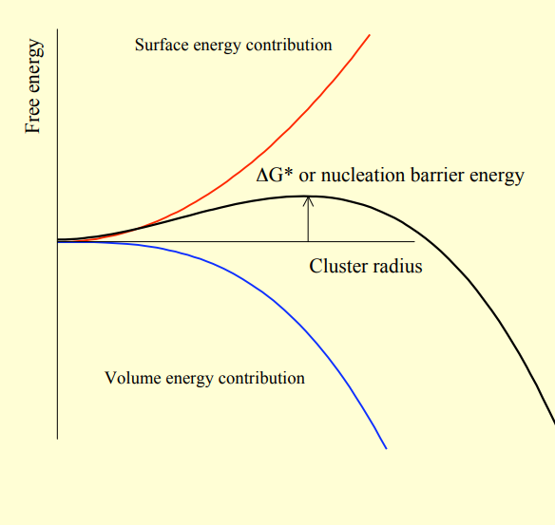
Nucleation, growth and Coarsening
Precipitation reactions involve nucleation, growth and coarsening.
In nucleation tiny volumes of product phase called nuclei form on the matrix because of thermodynamic fluctuation.

Slide 3
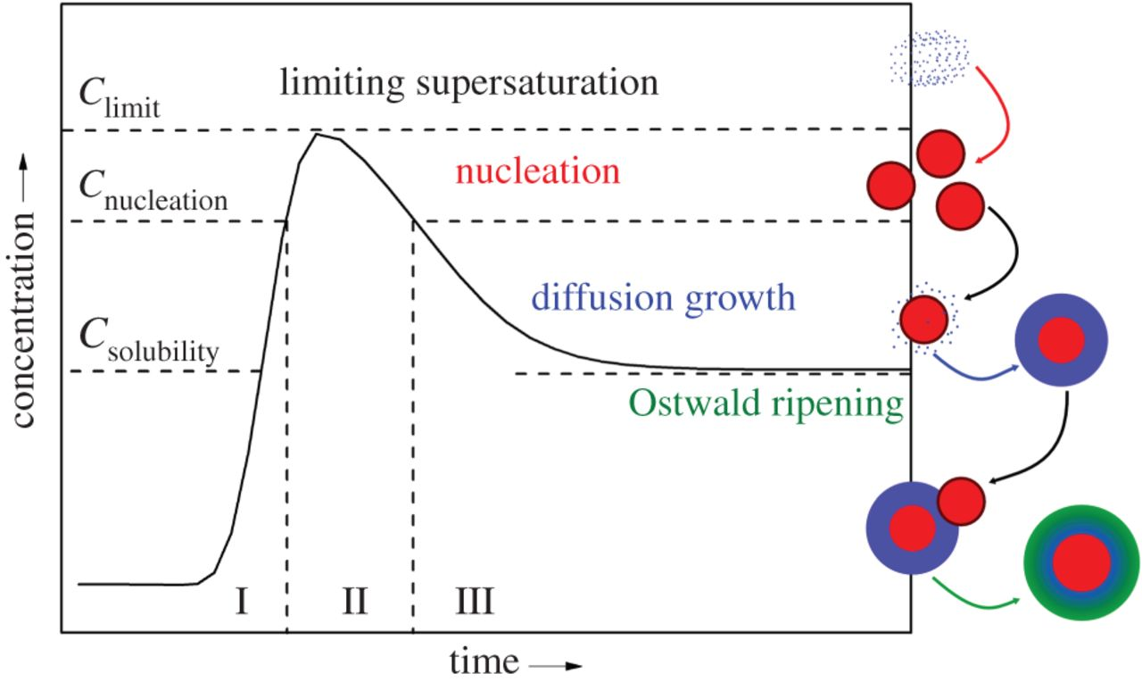
Once the nuclei with size > critical radius Rc is formed they grow in size to reduce the free energy.
During growth the volume fraction of the precipitate phase increases till equilibrium is reached.
During coarsening the larger precipitates grow at the expense of smaller precipitates while maintaining local equilibrium.
A metastable state evolves towards the stable equilibrium state via localized fluctuations.

Slide 4
Coarsening
Structural change in which the average size of the precipitate particles in a system increases with time usually after the precipitation is complete.
Oswald ripening, coalescence and over aging are commonly used to refer to coarsening
During coarsening, the overall volume of the precipitates remain the same.
The average particle size and distance of separation between neighborhood particles increase.
Decreases the number of particles
The stress required to move a dislocation through matrix in which precipitates are embedded decreases which results in loss of strength.
Coarsening increases with increase in temperature.
Driving force:
Microstructure of a two phase alloy is unstable if the total interfacial free energy is not minimum.
Reduction in total interfacial energy

Slide 5
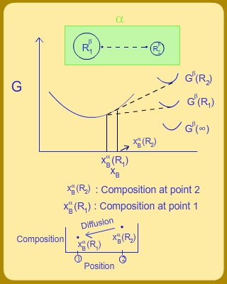
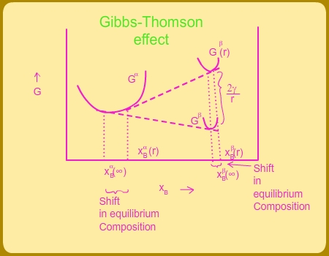
Gibbs Thomson effect
There will be range of particle sizes due to differences in the time of nucleation and growth.
Due to Gibbs Thomson effect , the solute concentration in the adjacent to matrix increases as radius of curvature decreases.
This results in development of concentration gradient in the matrix.
This results in solute atoms transport from smaller particles to larger particles.
The smaller precipitates shrink and the larger precipitates grow

Slide 6
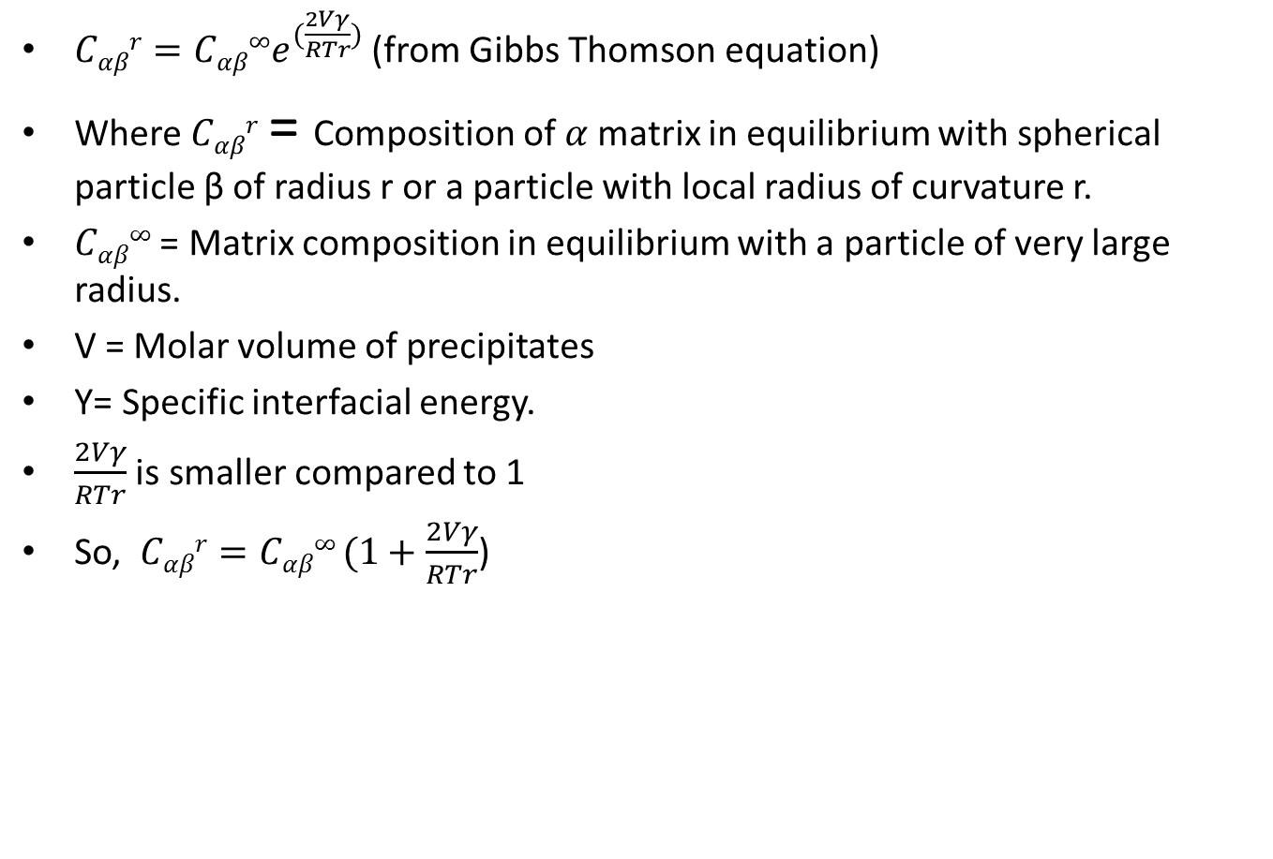
$Cαβr=Cαβ∞e^{(\frac{2Vγ}{RTr})}$ (from Gibbs Thomson equation)
Where $Cαβr$ = Composition of $α$matrix in equilibrium with spherical particle β of radius r or a particle with local radius of curvature r.
$Cαβ∞$ = Matrix composition in equilibrium with a particle of very large radius.
V = Molar volume of precipitates
Υ= Specific interfacial energy.
$\frac{2Vγ}{RTr}$ is smaller compared to 1
So, $Cαβr=Cαβ∞ (1+\frac{2Vγ}{RTr}$)

Slide 7
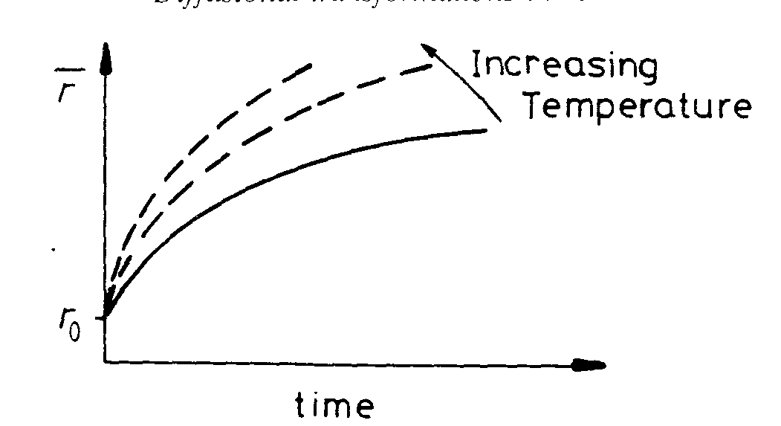
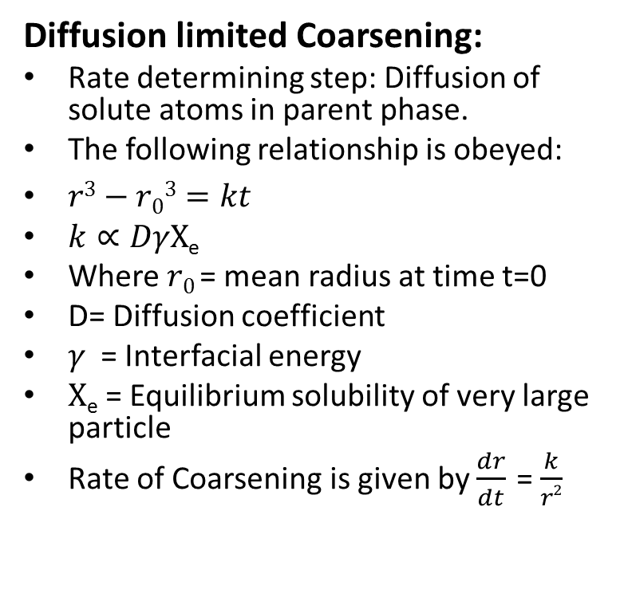
Diffusion limited and Interface limited coarsening
Diffusion limited Coarsening:
Rate determining step: Diffusion of solute atoms in parent phase.
The following relationship is obeyed:
$r3−r03=kt$
$k∝DγX$_{e}
Where $r0$ = mean radius at time t=0
D= Diffusion coefficient
$γ$= Interfacial energy
$X$_{e} = Equilibrium solubility of very large particle
Rate of Coarsening is given by $\frac{dr}{dt}$ = $\frac{k}{r2}$

Slide 8

Interface limited coarsening
Jump across the interface is the rate determining step.
Average the particle size distribution is given by
$r2−r02=Kt$
$r ∝t1/2$

Slide 9
Factors affecting coarsening
Y :
Increase in ϒ increases the rate of coarsening. The heat-resistant Nimonic alloys based on Ni-Cr with additions of Al and Ti obtain their high strength from a fine dispersion of the ordered fcc phase Ni₃ (TiAl) (Y') which precipitates in the fcc Ni-rich matrix. The Ni/ϒʹ interfacial energy is very low thus enabling it to retain fine structure at high temperature.
X_{e}:
High strength at high temperatures can also be obtained with fine oxide
dispersions in a metal matrix. For example W and Ni can be strengthened for high temperature use by fine dispersions of thoria ThO₂. In general oxides
are very insoluble in metals and the stability of these microstructures at high
temperatures can be attributed to a low value of Xe.
D :
Cementite dispersions in tempered steels coarsen very quickly due to the high
diffusivity of interstitial carbon. However, if the steel contains a substitutional
alloying element that segregates to the carbide, the rate of coarsening becomes
limited by the much slower rate at which substitutional diffusion can occur.

Slide 10
How do we measure coarsening
Average size
Size distribution
Volume fraction.

Slide 11
LSW theory
The mechanisms associated with particle coarsening was first described by Lifshitz and Slyozov, and Wagner
LSW theory, predict the coarsening of dispersed particles in a matrix to follow the general relationship r³ =kt.
Assumptions:
(a) the coarsening second phase is spherical with radius R,
(b) the particles are fixed in space,
(c) the inter-particle distances between the particles are infinitely large compared with the particle radius, which means that there is no interaction among the particles, and the volume fraction of the dispersed phase is infinitesimally small (i.e. infinitely dilute system),
(d) both the particles and matrix are fluids, and
(e) the solute atoms diffuse to the spherical particles under steady-state condition.
Limitations:
The classical LSW model is applicable in regime of small volume fraction of coarsening phase. As volume fraction increases, the diffusion fields are overlapped. The far-field boundary conditions cannot hold any more. Thus, the deviation of LSW theory of coarsening is expected, so-called volume fraction effect.

Slide 12
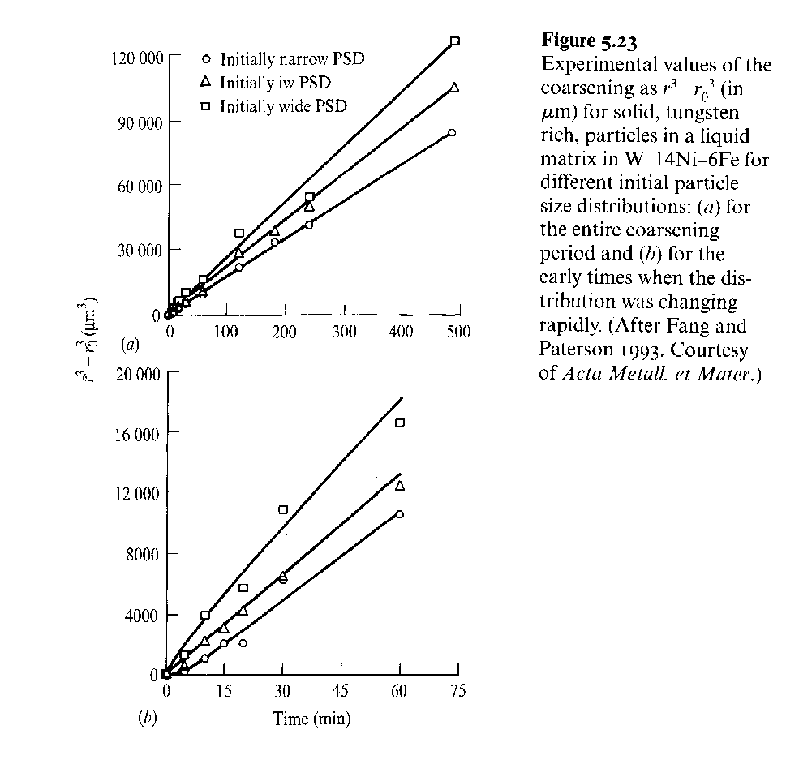

Slide 13
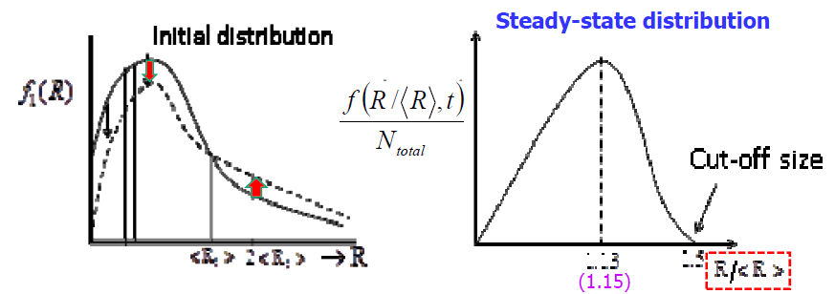
Evolution of particle size distribution

Slide 14
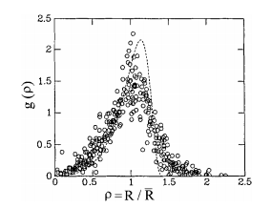
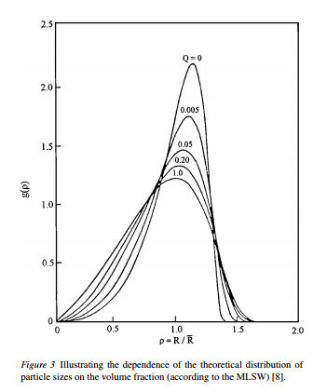
Indicates that particle size distributions from different alloys are broader than predicted by the mean-field theory of the LSW model.

Slide 15
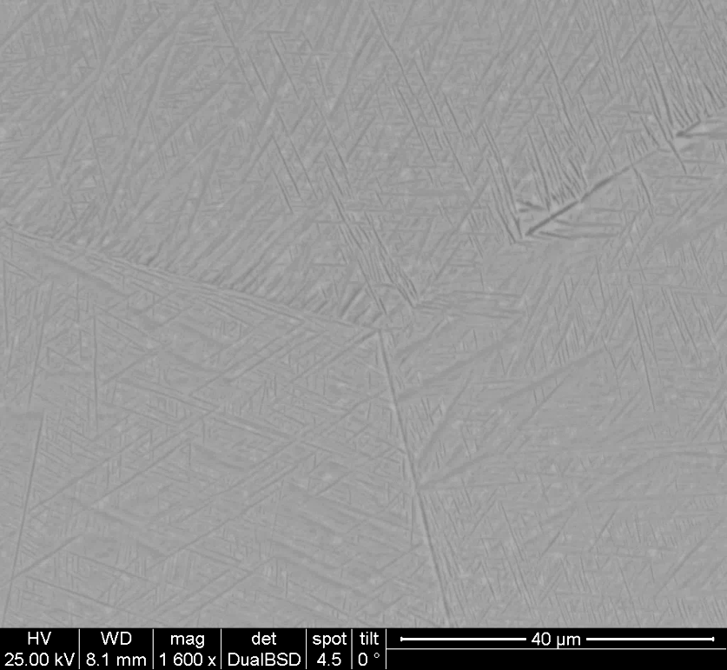
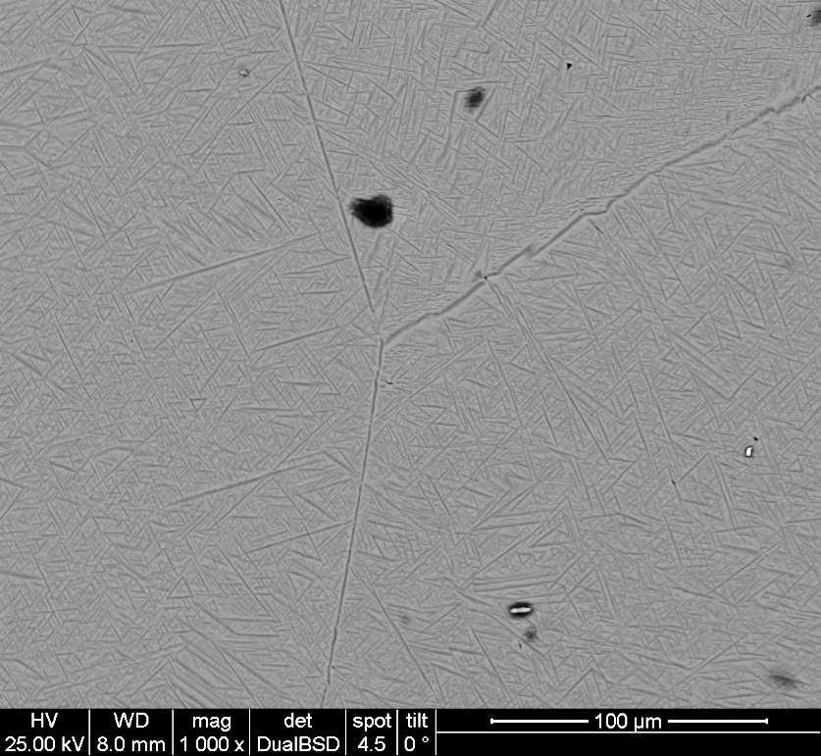
a
b
c
SEM micrographs of Ti-5553 alloy aged at 765˚C for (a) 12 min (b) 4.5hrs and (c) 144 hrs

Slide 16



a
b
Mean particle size= 4.069 $μ$m
Mean particle size= 2.361 $μ$m
c
Mean particle size= 9.798 $μ$m
Particle size distribution in Ti-5553 alloy aged at 765˚C for (a) 12 min (b) 4.5 hrs and (c) 144 hrs

Slide 17
Average volume fraction= 33.702$±$ 0.767

Slide 18
Thank You

